Slide 1
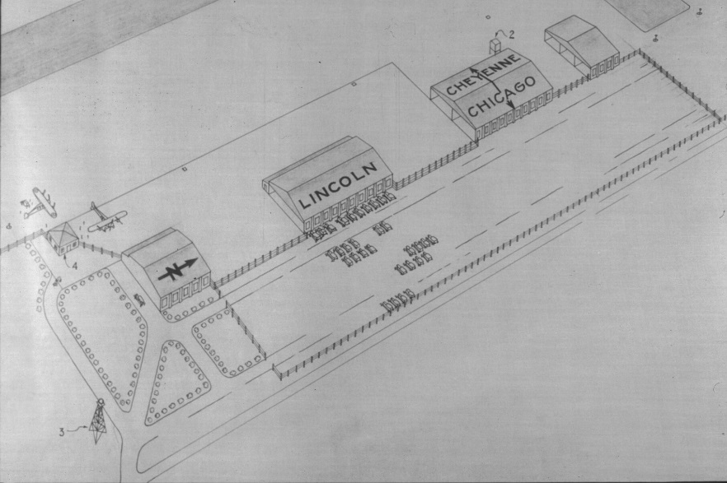
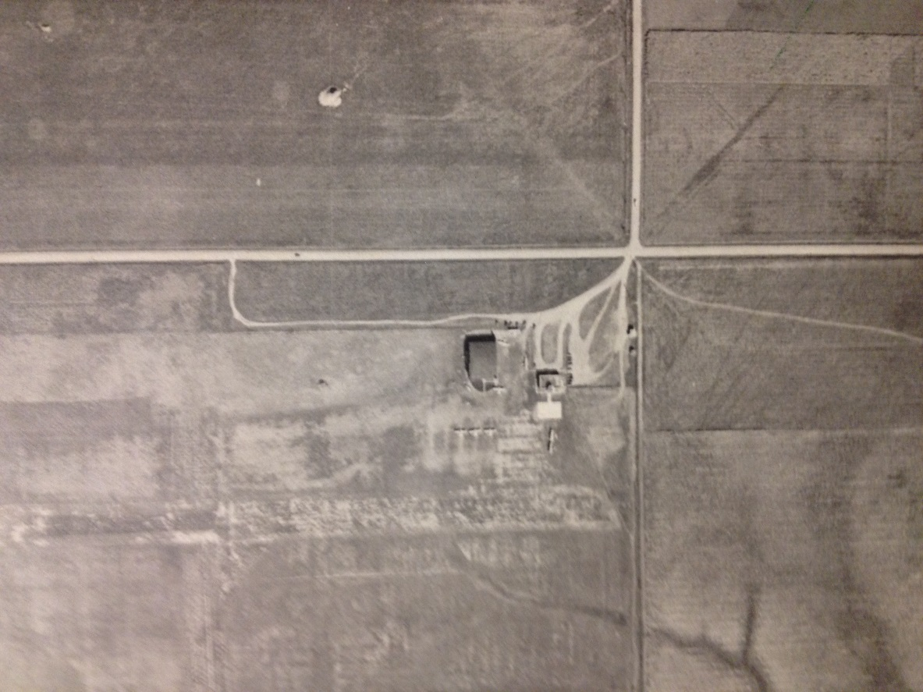
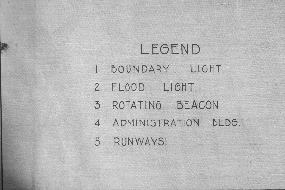
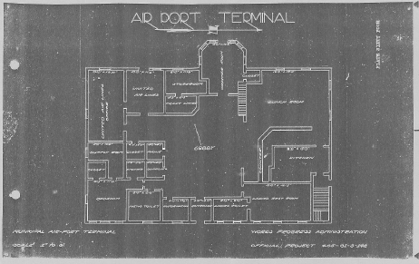
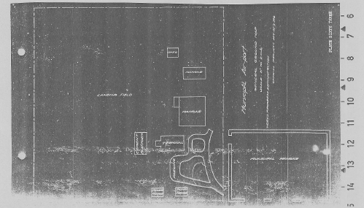
Early plan for Lincoln Municipal Airport, 1930s
1941 aerial photo of Lincoln Municipal Airport
1931 site plan for Lincoln Municipal Airport
1931 1st floor plan
for Lincoln Airport Terminal

Slide 2
Union Airport
Arrow Airport, looking north, N. 48 on right
1964:
Arrow Airport
1957 :
Arrow Airport
1959

Slide 3
